Slide 1
Atomic Theory

Slide 2
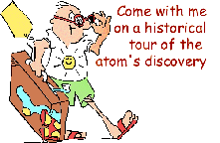
Let’s Take a Trip Through Time!

Slide 3
Atomic Theories Timeline
Name | Democritus | Dalton | Thomson | Rutherford | Bohr | Schrödinger Heisenberg
Time Frame
Key Points
Candy Model

Slide 4
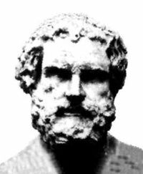
Democritus 460 – 370 B.C.
There are various basic elements from which all matter is made
Everything is composed of small atoms moving in a void
Some atoms are round, pointy, oily, have hooks, etc. to account for their properties
Ideas rejected by leading philosophers because void = no existence

Slide 5
First Concept of an Atom
Pick a Candy !

Slide 6
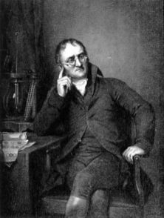
John Dalton 1766-1844
Introduced his ideas in 1803
Each element is composed of extremely small particles called atoms
All the atoms of a given element are identical, but they differ from those of any other element
Atoms are neither created nor destroyed in any chemical reaction
A given compound always has the same relative numbers and kinds of atoms

Slide 7
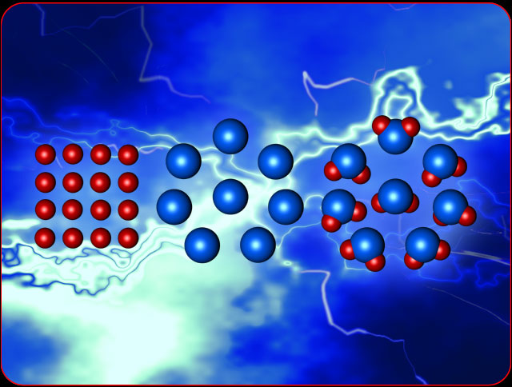
Dalton’s Model
Pick a Candy !

Slide 8
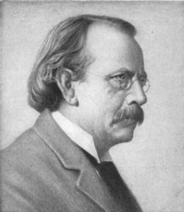
J.J. Thomson 1856-1940
Discovered electron 1897 – Cathode Ray Experiment
Plum Pudding model 1904
Electrons in a soup of positive charges
Discovered isotopes 1913

Slide 9
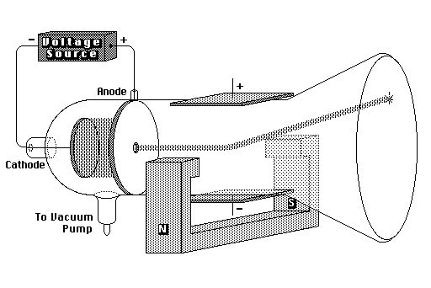
Cathode Ray Tube Experiment

Slide 10
The Electron
J.J. Thomson 1897 - CRT experiment
Negative Charge
e⁻
Actual Mass: 9.11 x 10⁻²⁸g
Relative mass information - discovered later 1/1840 the mass of proton

Slide 11
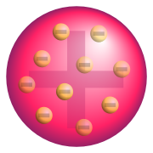
Plum Pudding Model
Pick a Candy!

Slide 12
The Proton
Goldstein 1886 - CRT canal rays
Positive charge
p⁺
Actual Mass: 1.67 x 10⁻²⁴g
Relative mass: 1

Slide 13
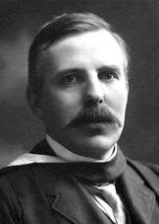
Ernest Rutherford 1871-1937
Nucleus Theory 1910
alpha particle gold foil experiment
An atom’s mass is mostly in the nucleus
The nucleus has a positive charge (Moseley)
Electrons in fixed orbit

Slide 14
Alpha Particle Experiment

Slide 15
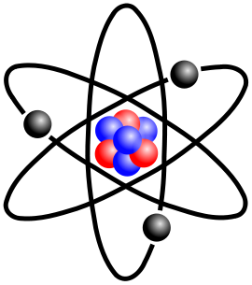
Rutherford Model
Pick a Candy!

Slide 16
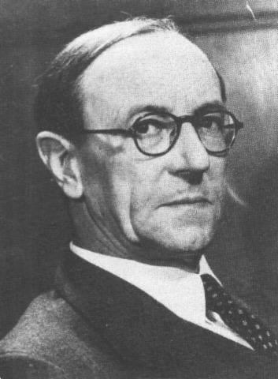
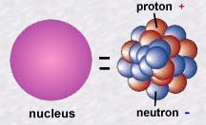
James Chadwick 1891-1974
Worked with Rutherford
Interpreted work of the Curies
Discovered Neutron 1932
Nobel Prize in Physics 1935

Slide 17
The Neutron
Chadwick 1932 - nuclear bombardment
No charge
n⁰
Actual Mass: 1.67 x 10⁻²⁴g
Relative Mass: 1

Slide 18
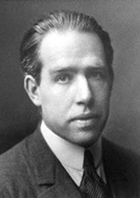
Niels Bohr 1885-1962
Planetary Model 1913
Nucleus surrounded by orbiting electrons at different energy levels
Electrons have definite orbits
Utilized Planck’s Quantum Energy theory
Worked on the Manhattan Project (US atomic bomb)

Slide 19
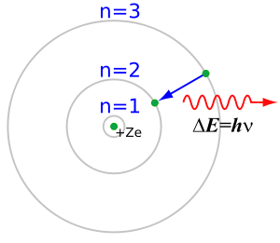
Bohr’s Model

Slide 20
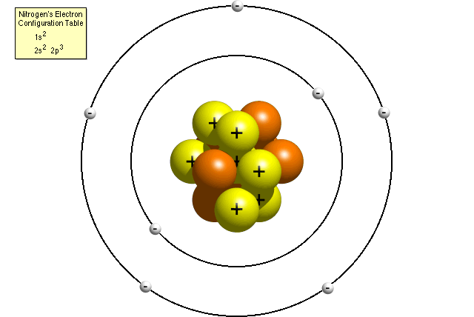
Bohr Model for Nitrogen
Pick A Candy!

Slide 21
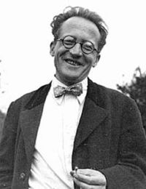
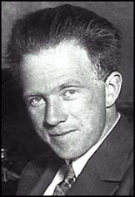
Ernst Schrödinger 1887-1961
Werner Heisenberg 1901-1976
Quantum Mechanical Model 1926
Electrons are in probability zones called “orbitals”, not orbits and the location cannot be pinpointed
Electrons are particles and waves at the same time
Developed quantum numbers based on theories of Einstein and Planck

Slide 22
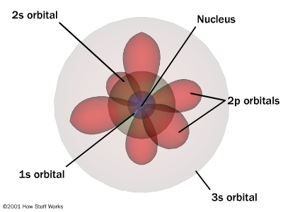
Orbitals

Slide 23
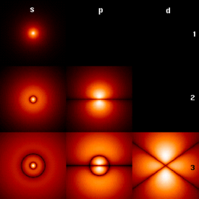
Quantum Mechanical Theory Electron in a Hydrogen atom
Pick A Candy!

